Slide 1

ESG ETFs VS Non- ESG EFTs
Data Analysis:
My SQL, Excel, Python, Power BI

Slide 2





Meet the Team...
Chun Man
Mariyah Afsana
Clesha James
Enrico Carrer

Slide 3
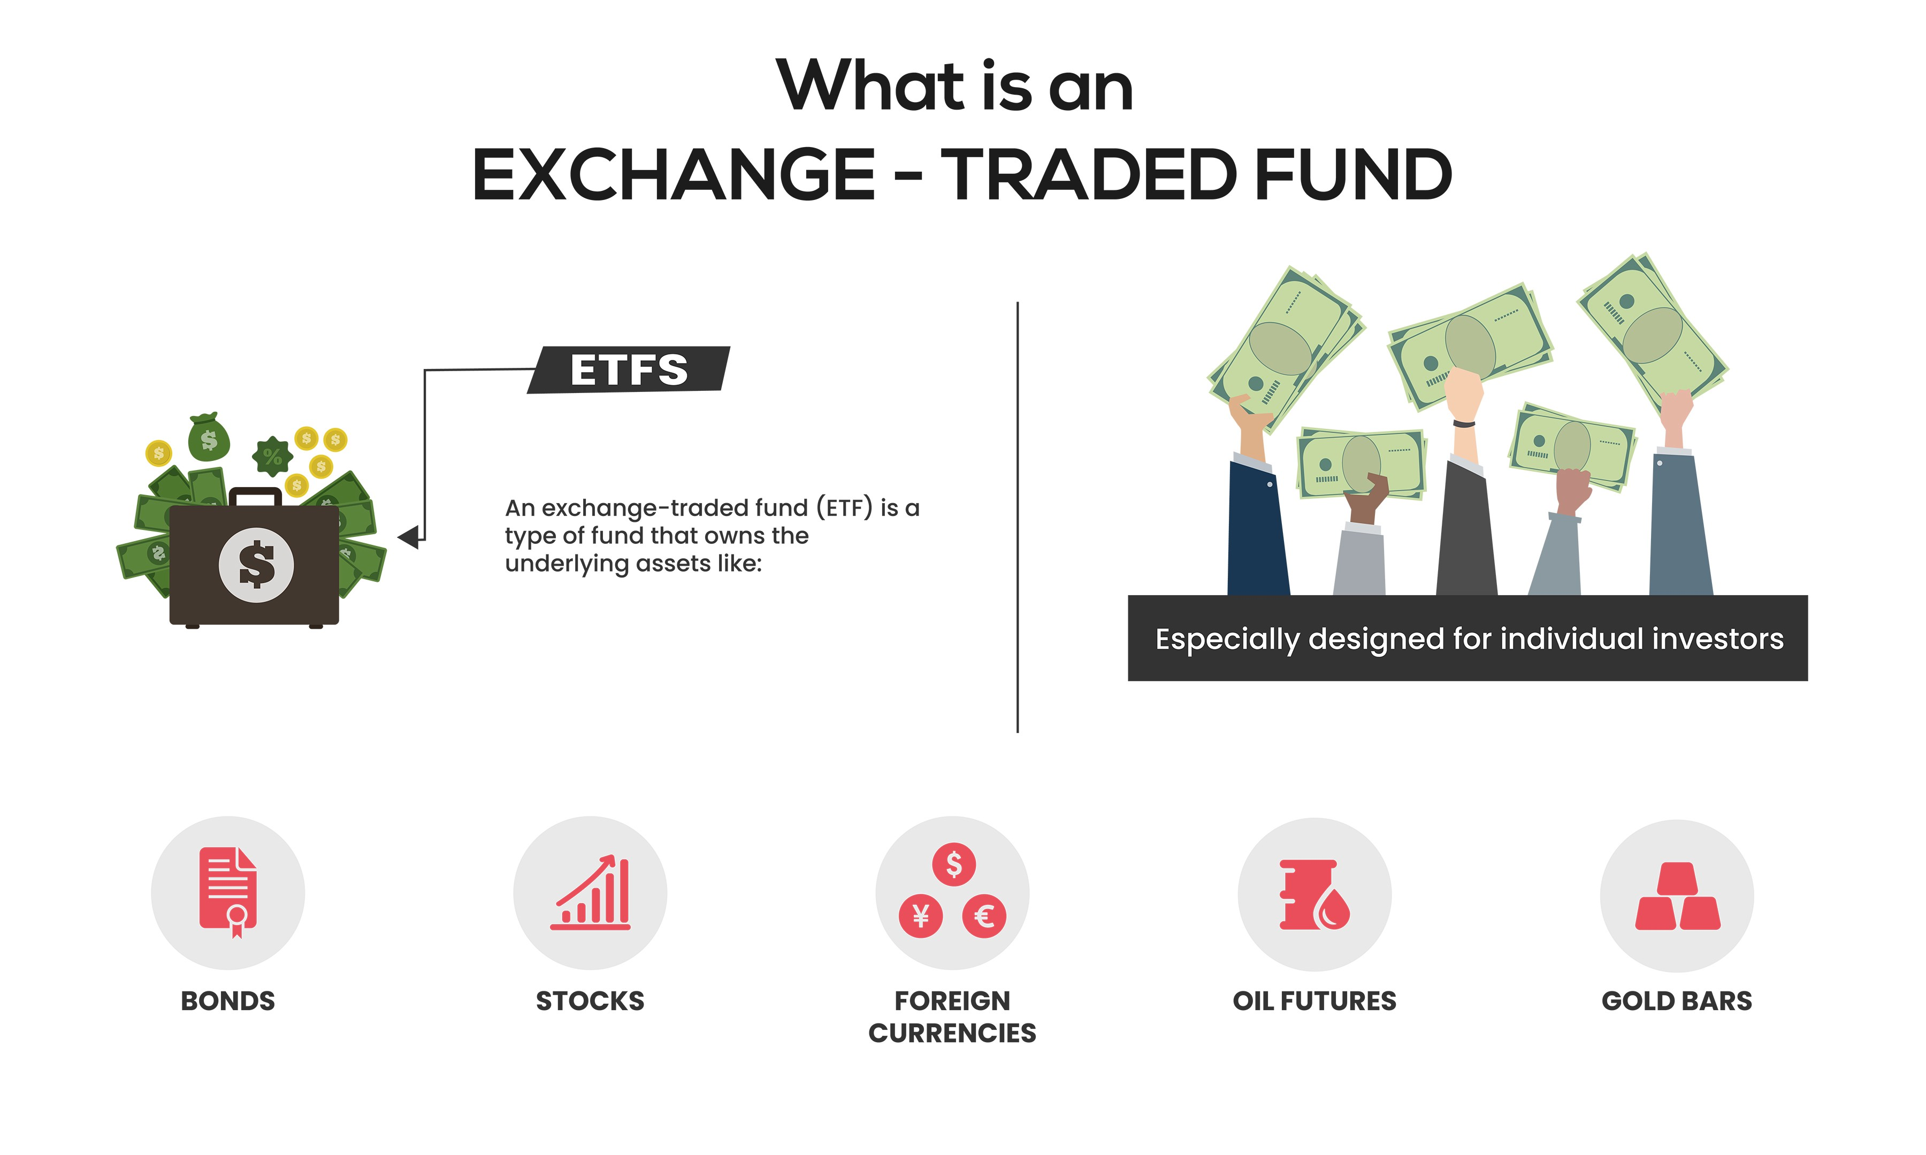
Exchange Traded Funds
ESG ETFs | Non-ESG ETFs | Market
DSI VSGX ESGE IESG | SPY VXUS VWO VGK | United States of America Global (without USA) Emerging Europe

Slide 4

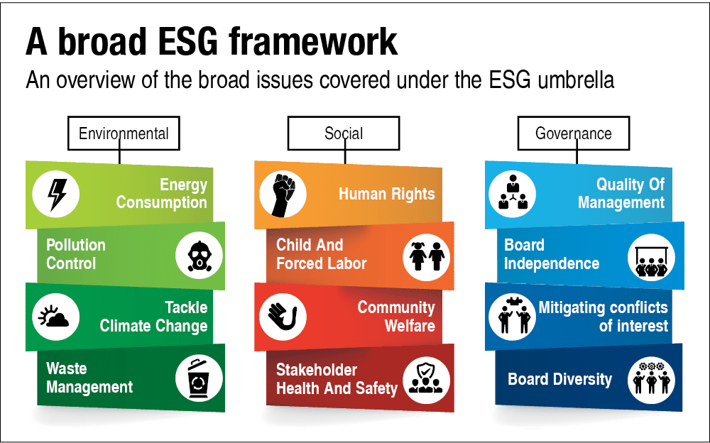





Environmental, Social, & Governance

Slide 5

What is the Goal?

Slide 6
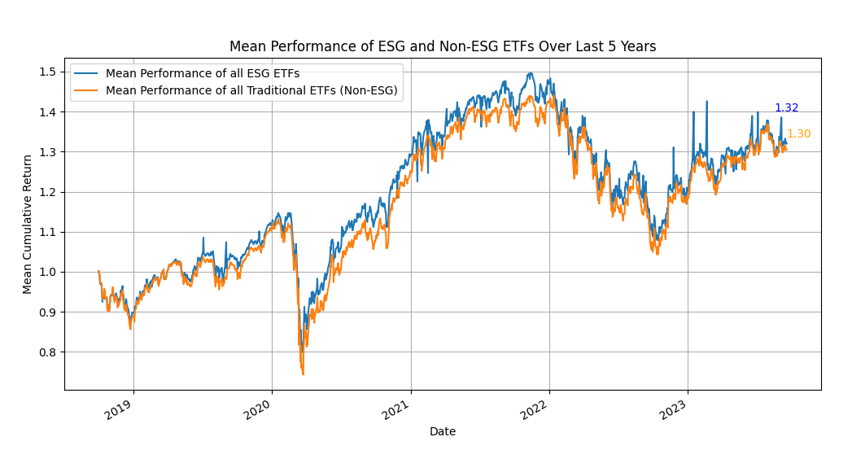
Combined ESG VS Non- ESG

Slide 7
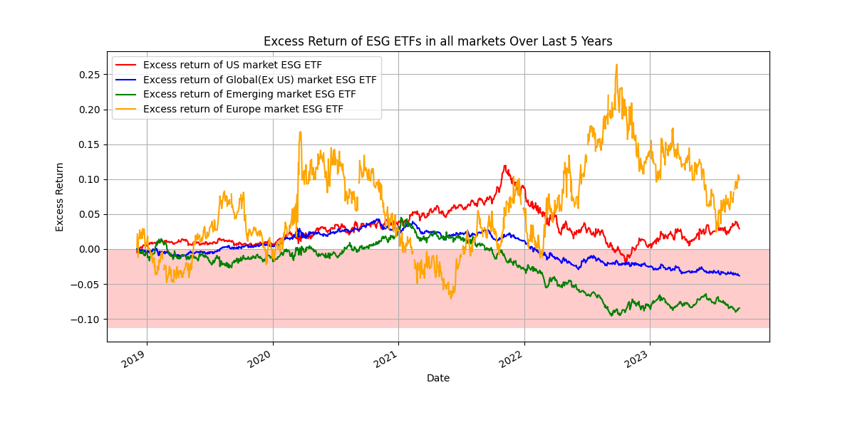
ESG Excess Return Performance

Slide 8
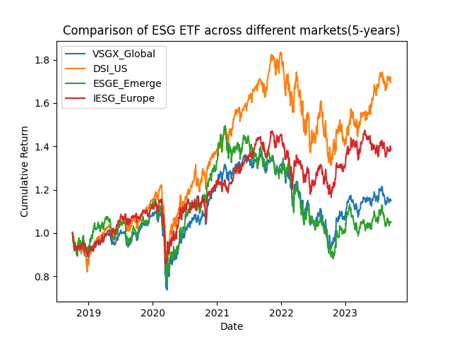
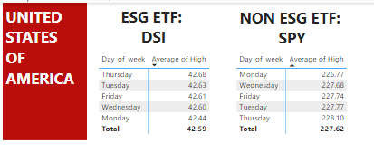
ESG All Market Comparision
FUN FACT

Slide 9
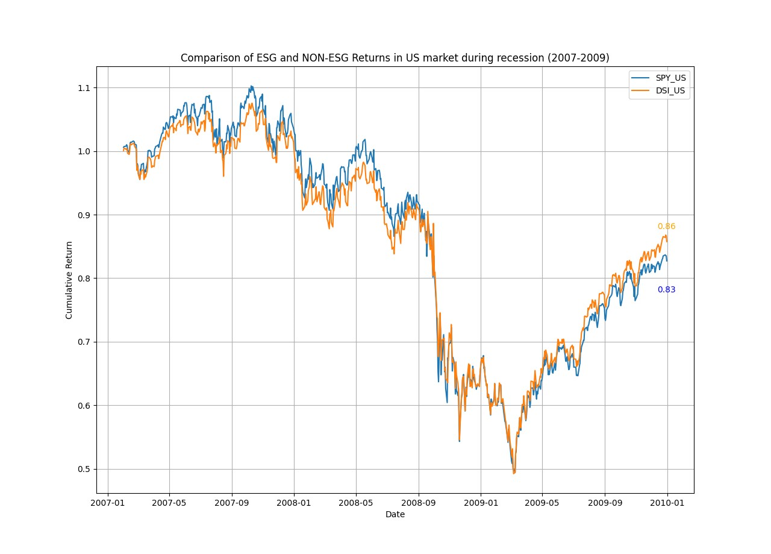
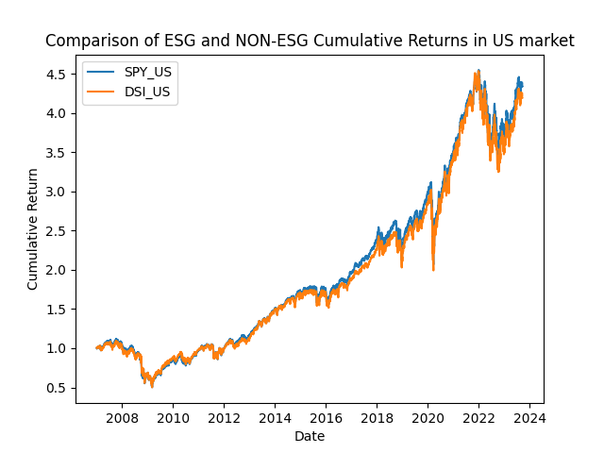
US Market & Economic Recession Performance

Slide 10
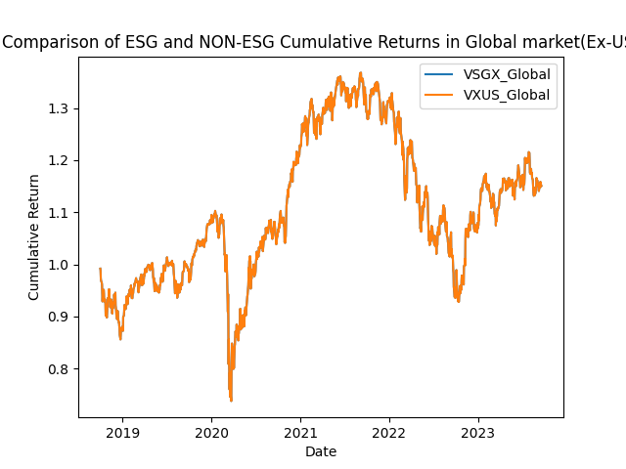
Global Market

Slide 11
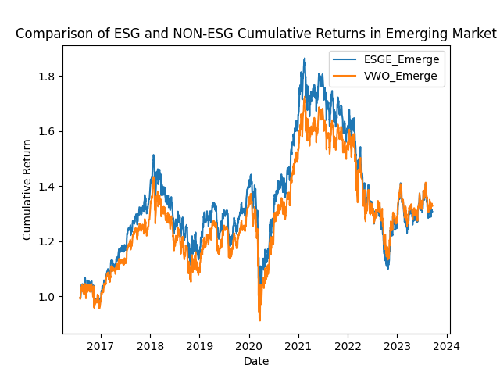
Emerging Market

Slide 12
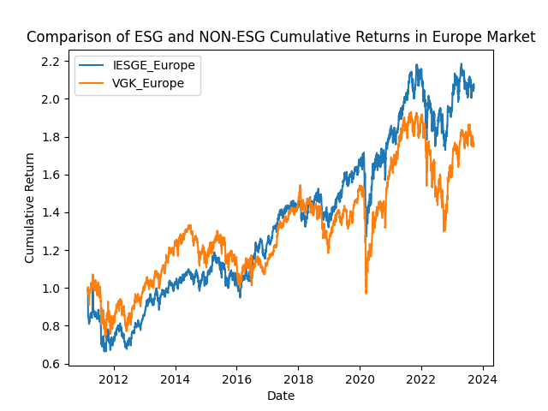
Europe Market

Slide 13
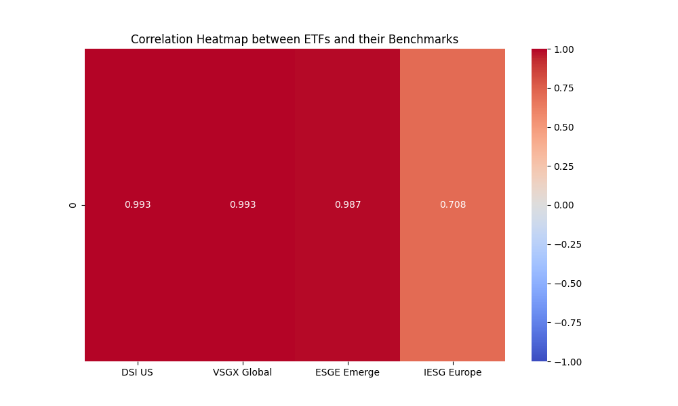
Correlations of all Markets

Slide 14
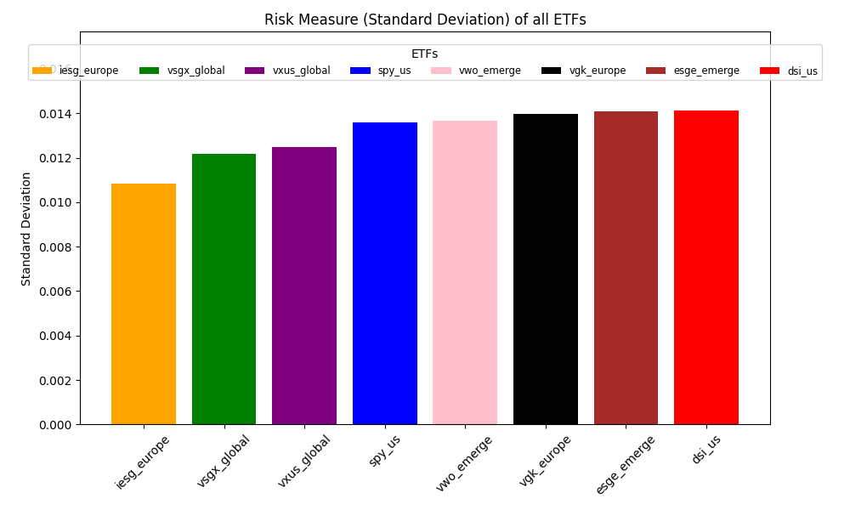
Standard Deviation(Risk) of all Markets

Slide 15
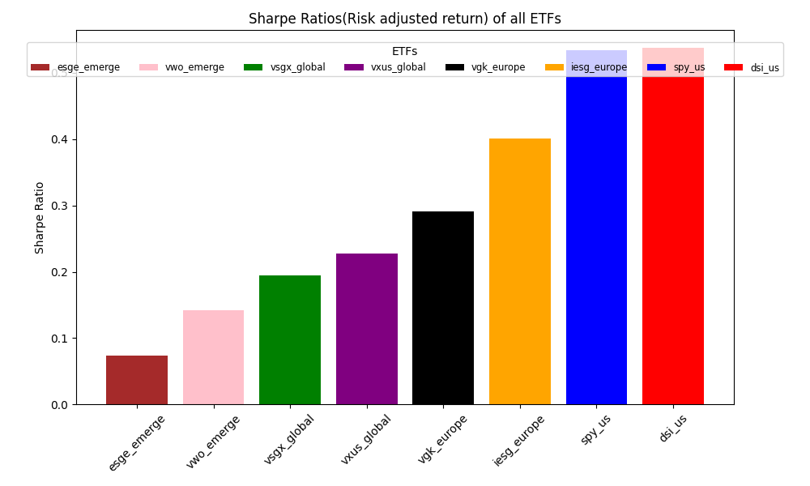
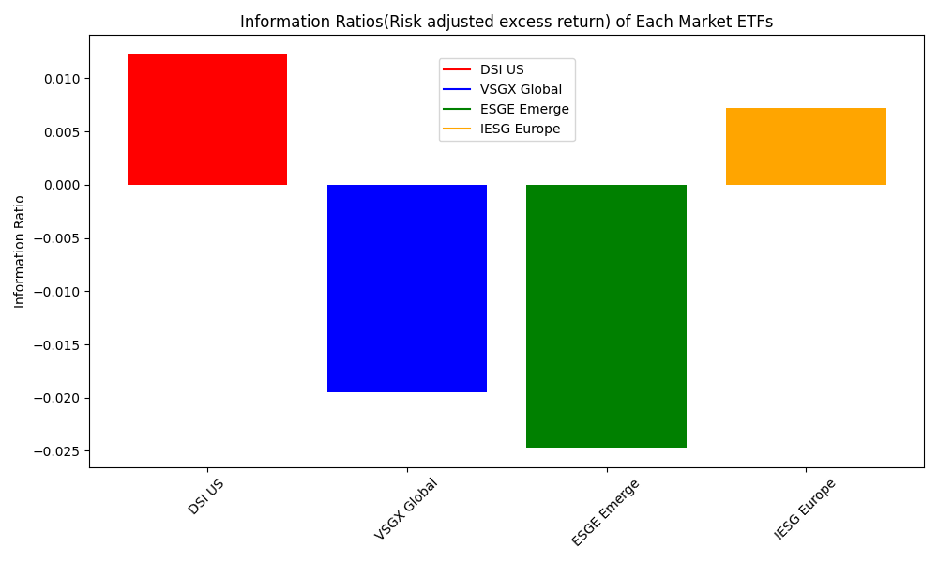
Sharp Ratio and information Ratio(Risk Adjusted Return)

Slide 16
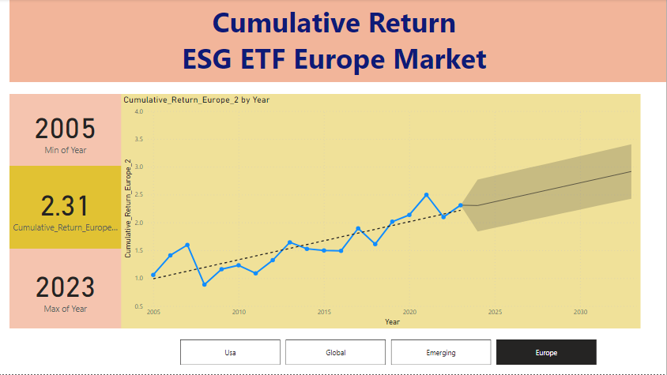
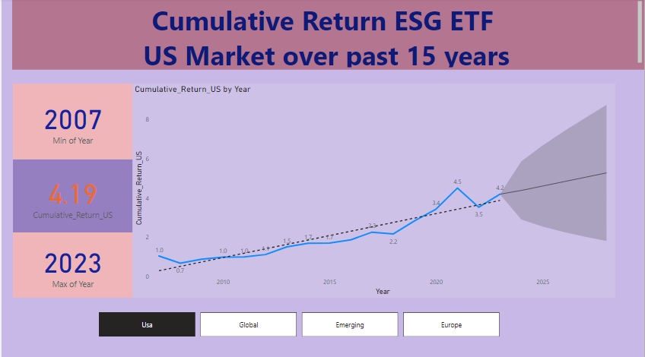
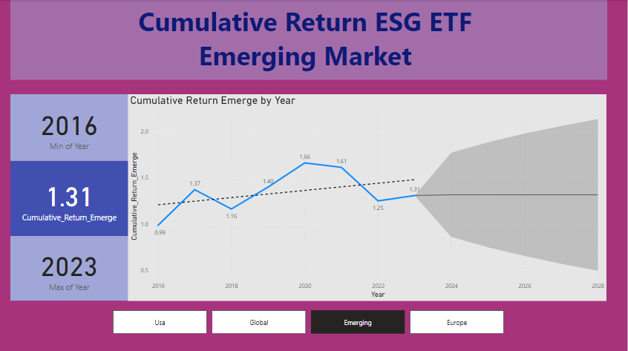
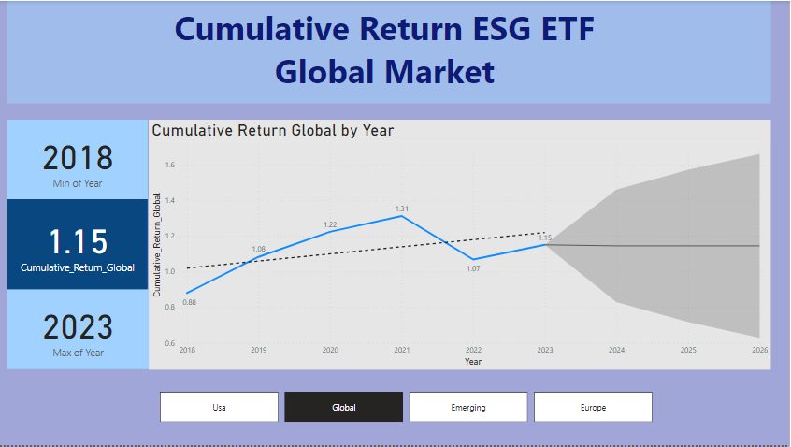
POWER BI

Slide 17
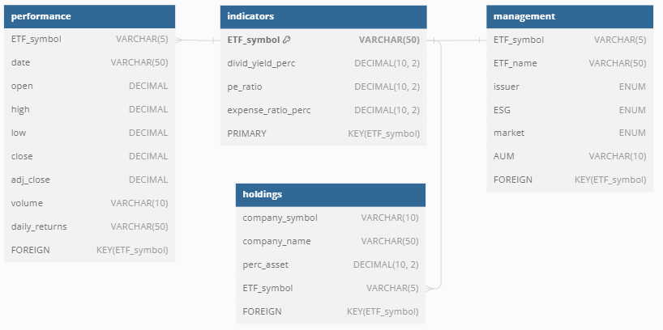
MySQL - Diagram
Link to the Database & table creation: https://mafsana.atlassian.net/l/cp/jLSpXyVH
Link to the Database design: https://docs.google.com/spreadsheets/d/16wU-p3tpzPvqwjQoJE2033xhr9DVJ5wdgkTsV526Gls/edit?usp=sharing

Slide 18
MySQL - Questions
What are the top 5 holdings in each market pair?
Which geographical area has the best dividend yield among the ESG funds?
Which geographical area has the best dividend yield among the non-ESG funds?
Link to the original MySQL analysis: https://mafsana.atlassian.net/l/cp/0Uw22yeo

Slide 19
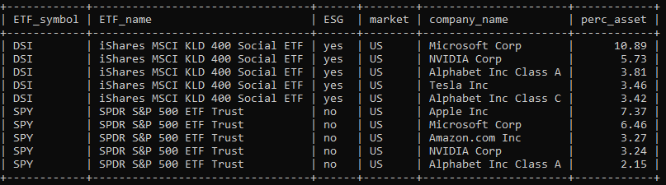
MySQL - Question 1
1.1. What are the top 5 holdings in the US ETFs?

Slide 20
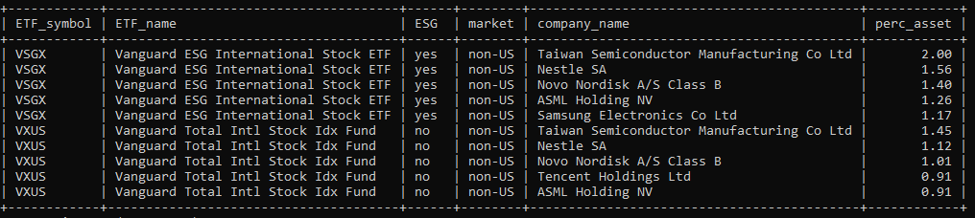
MySQL - Question 1
1.2. What are the top 5 holdings in the Global EX-US ETFs?

Slide 21
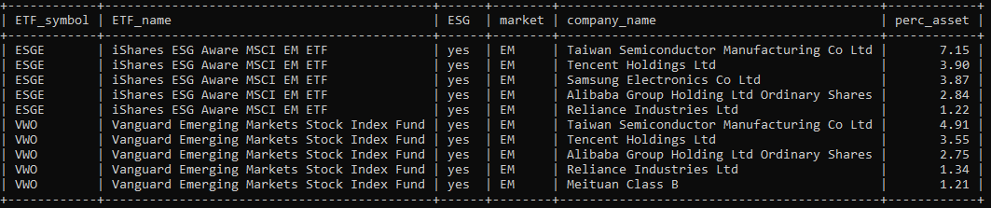
MySQL - Question 1
1.3. What are the top 5 holdings in the E.M. ETFs?

Slide 22
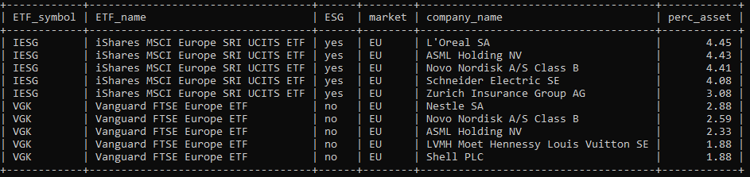
MySQL - Question 1
1.4. What are the top 5 holdings in the Europe ETFs?

Slide 23
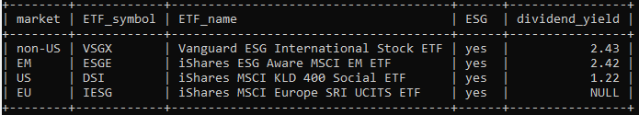
MySQL - Question 2
2. Which geographical area has the best dividend yield among the ESG funds?

Slide 24
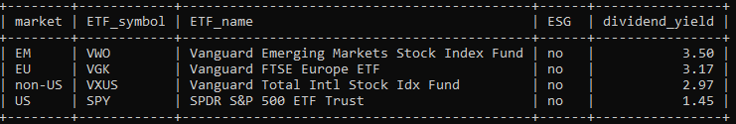
MySQL - Question 3
3. Which geographical area has the best dividend yield among the non-ESG funds?

Slide 25
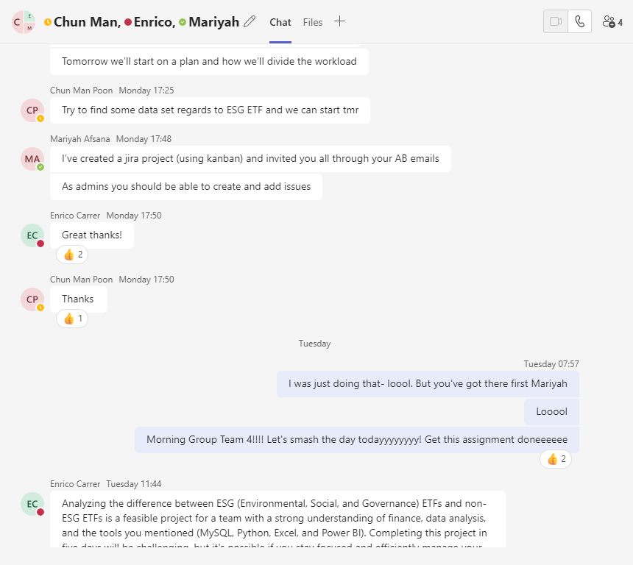


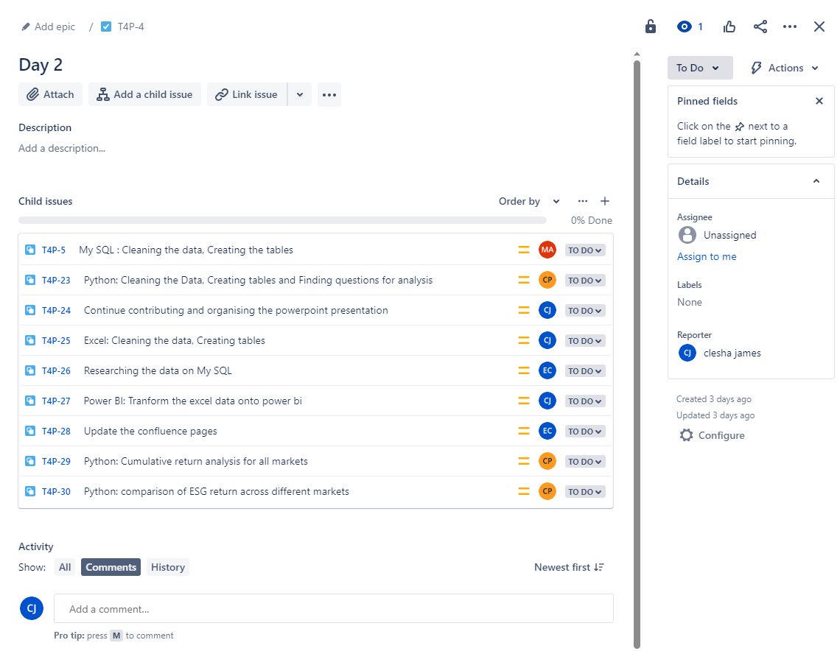
Agile Practices

Slide 26

It's your choice... ESG ETFs VS Non- ESG EFTs

